Slide 1
Cognos Macros
3-15-2013
Bryan Mack

Slide 2
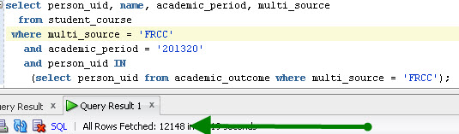
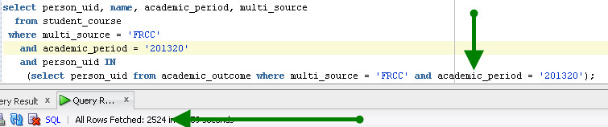
Nested Query in SQL
Refer to the following 2 SQL scripts in SQL Developer:
Query 1:
Query 2:
The “academic_period” filter on the nested query limits the results.

Slide 3
Nested Query in Cognos
In Cognos, we dynamically filter data based on prompt values input by the user.
When using Custom SQL for a report’s source, Cognos provides filters for us to filter data.
But what exactly is it filtering?

Slide 4
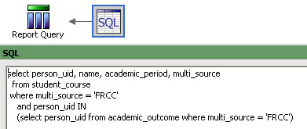

Cognos Filters
Our first SQL Script is embedded to Cognos as a Query, minus the academic period:
Then a filter is added to the query via Cognos

Slide 5

Cognos Filters
If we use term 201320, and export our result set to Excel, we can see that we have 12148 results (the top 2 rows in Excel are header rows)
Keep that number in your mind – 12148…..

Slide 6
12148 Results?
Let’s revisit slide 2’s results:
Query 1:
Query 2:
Shouldn’t we be limiting this to 2524 results? Cognos is not applying the filter to the nested query

Slide 7
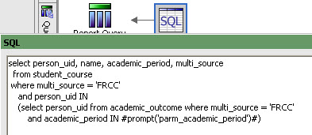
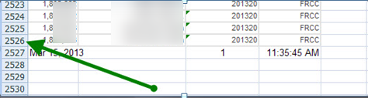
Cognos Macros
This is where Cognos Macros come in, we can filter the prompt values wherever we desire:
Result of this query, exported to Excel: 2524 rows

Slide 8
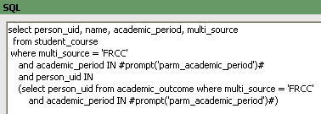
Cognos Macros
The Cognos Macro has fixed the issue. To take this further, I’d recommend, when using Custom SQL, to keep all filters in one place, even though the Cognos filter works on the outer-most query, just to keep things clear:

Slide 9
Macros Syntax (mandatory prompts)
compare dates
<field> = to_date(#prompt('parm_date')#,'yyyy-mm-dd')
compare characters (equal)
<field> = #prompt('parm_multi_source')#
compare characters (in)
<field> IN (#promptmany('parm_carrier')#)

Slide 10
Macro Syntax (optional prompts)
As we know, when optional prompts exist, ignoring the prompt ignores the filter altogether. However, if you have a macro embedded, it will assume you selected nothing and give you incorrect results.
You have to “trick” Cognos into treating a Macro like an optional prompt

Slide 11
Macro Syntax (optional prompts)
Method #1
and (
<field> IN (#promptmany('parm_carrier','string',sq('NotSelected'))#)
OR
('NotSelected') in (#promptmany('parm_carrier','string',sq('NotSelected'))#)
)
Method #2 <field> IN
(#promptmany('parm_carrier','string',’<field>’)#)

Slide 12
Macro Syntax (Cognos date prompts)
<field> = to_timestamp(#prompt(‘parm_date')#,'YYYY-MM-DD"T"HH24:MI:SS.ff3')
This syntax is necessary if you are using the Cognos 10 provided date prompts, because sometimes the values returned to the parameters are in ISO 8601 format.

